Slide 1


Slide 2
Chapter 10
Mixed Methods Procedures

Slide 3
Introduction
Mixed methods procedures section
  Combining qualitative and quantitative forms for more understanding
  Nature of mixed methods
  Reasons to use
  The design
  Ethical issues

Slide 4
Components of Mixed Methods Procedures
Set of procedures can be used for planning
Journals emphasizing mixed methods
  Journal of Mixed Methods Research
  International Journal of Multiple Research Approaches
  Quality and Quantity
  Field Methods
Applications across disciplines

Slide 5
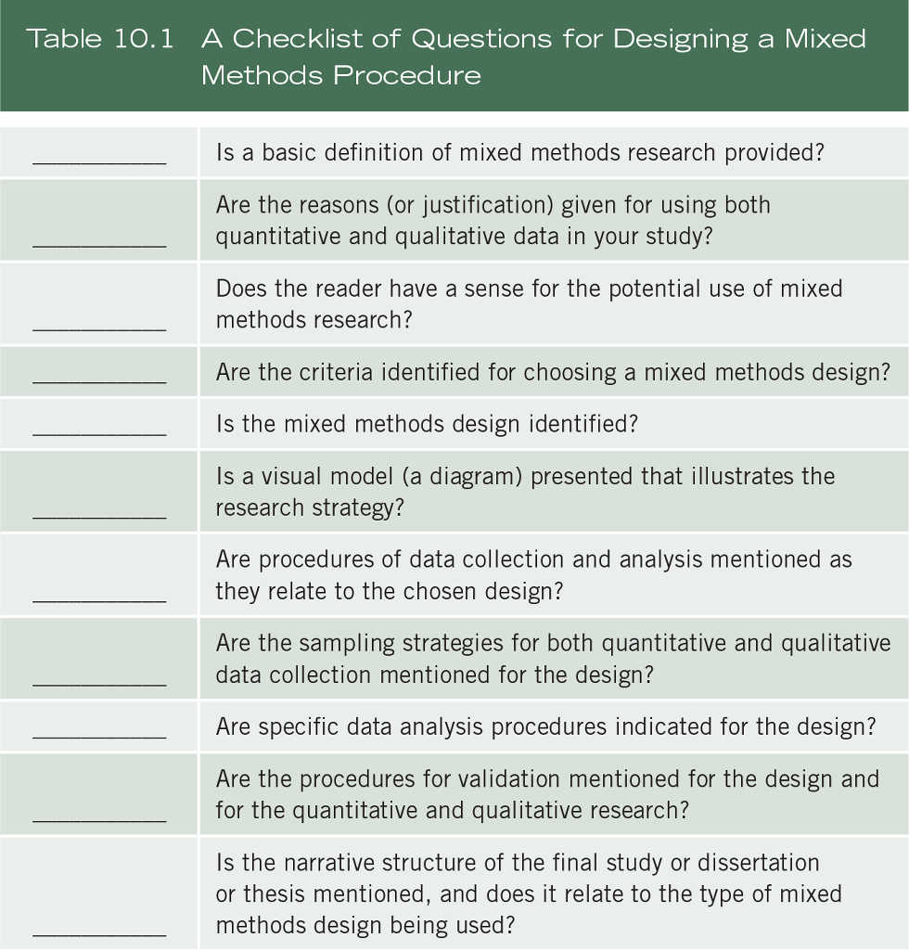
Components of Mixed Methods Procedures

Slide 6
Components of Mixed Methods Procedures
Describe mixed methods research:
Begin by defining mixed methods
  Collection of both qualitative and quantitative data
  Rigorous methods
  Integration of the two forms of data
  Procedures incorporated into a methods design
  Often informed by philosophy or theory

Slide 7
Components of Mixed Methods Procedures
Describe mixed methods research:
Many different terms are used for this approach; recent writings tend to use the term mixed methods
Background of mixed methods – reviewing the history of this approach

Slide 8
Components of Mixed Methods Procedures
Describe mixed methods research:
Reasons for choosing mixed methods
  Comparing perspectives
  Explaining quantitative results with qualitative
  Developing measurement instruments
  Augmenting experiments
  Developing cases
  Understanding changes needed for marginalized group
  Evaluating processes and outcomes

Slide 9
Components of Mixed Methods Procedures
Describe mixed methods research
Indicate the type of mixed methods design and the rationale for choosing it
Challenges to design

Slide 10
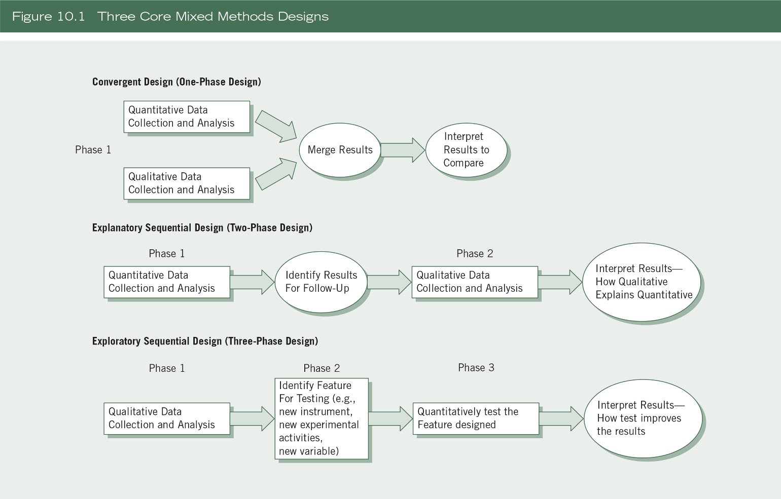
Types of Mixed Methods Designs

Slide 11
Types of Mixed Methods Designs
Convergent mixed methods design (Figure 10.1)
Description of the design
  Collects both quantitative and qualitative data,
  Analyzes them separately,
  Compares the results to see if the findings confirm or disconfirm each other

Slide 12
Types of Mixed Methods Designs
Convergent mixed methods design (Figure 10.1)
Data collection
  Use the same or parallel variables, constructs, or concepts
Data analysis and integration
  Analyze qualitative database
  Analyze quantitative database
  Integrate the two
  Joint display – merge forms of data in a single visual display

Slide 13
Types of Mixed Methods Designs
Convergent mixed methods design:
Interpretation
  Discussion section compares results and notes convergence or divergence
Validity
  Quantitative validity (e.g., construct)
  Qualitative validity (e.g., triangulation)
  Mixed methods validity (e.g., unequal sample sizes)

Slide 14
Types of Mixed Methods Designs
Explanatory sequential mixed methods design:
Description of the design
  Involves a two-phase project
  Collection of quantitative data in the first phase
  Uses results to plan the second, qualitative phase
  Qualitative data help in explain in more detail the initial quantitative results

Slide 15
Types of Mixed Methods Designs
Explanatory sequential mixed methods design:
Data collection
  Two distinct phases
  Rigorous quantitative sampling and purposeful qualitative
Data analysis and integration
  Connecting quantitative results to qualitative data collection
  Quantitative results inform sampling and qualitative questions to ask

Slide 16
Types of Mixed Methods Designs
Explanatory sequential mixed methods design:
Interpretation
  First phase quantitative results
  Second phase qualitative results
  How the qualitative findings help to explain the quantitative results
Validity
  Of the scores from the quantitative measures and qualitative findings
  Mixed methods (e.g., options for following up on quantitative results)

Slide 17
Types of Mixed Methods Designs
Exploratory sequential mixed methods design:
Description of the design
  Start with a qualitative phase
  Build to a feature to be tested (e.g., survey instrument)
  Followed by a quantitative phase that tests the feature

Slide 18
Types of Mixed Methods Designs
Exploratory sequential mixed methods design:
Data collection
  Initial qualitative data collection
  Test of quantitative feature
Data analysis and integration
  Use the findings from the initial exploratory database to build into a feature
  Qualitative findings inform design of quantitative phase (e.g., instrument, variables)

Slide 19
Types of Mixed Methods Designs
Exploratory sequential mixed methods design (Figure 10.1):
Interpretation
  First report the qualitative finding
  Development of feature
  Quantitative test results
  Determine if qualitative themes can be generalized

Slide 20
Types of Mixed Methods Designs
Validity
  Validity of the qualitative data and the quantitative scores
  Mixed methods issues (e.g., developing a good instrument)

Slide 21
Types of Mixed Methods Designs
Several complex mixed methods designs:
Intersecting a secondary method (mixed methods) within a primary quantitative or qualitative design (e.g., an intervention)
Intersecting mixed methods within another methodology (e.g., evaluation)
Intersecting mixed methods within a theoretical framework (e.g., social justice)

Slide 22
Types of Mixed Methods Designs
Several complex mixed methods designs:
Mixed methods experimental (intervention) design – quantitative and qualitative data within an experiment or trial
Mixed methods case study design – mixed methods within a single or multiple case study

Slide 23
Types of Mixed Methods Designs
Several complex mixed methods designs:
Mixed methods participatory social justice design – core mixed methods design within a larger framework
Mixed methods evaluation design – one or more core designs in an evaluation

Slide 24
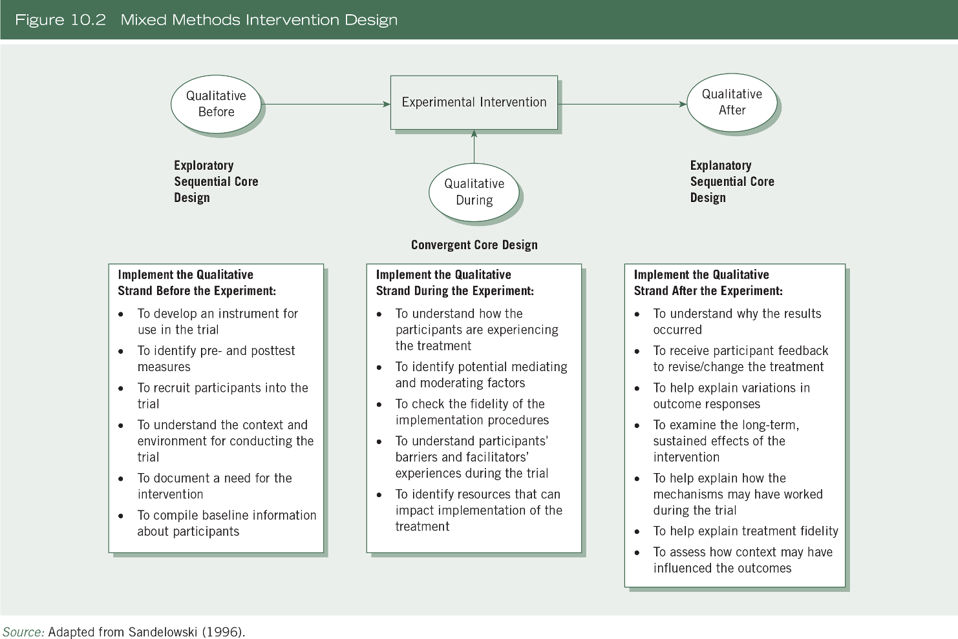
Types of Mixed Methods Designs

Slide 25
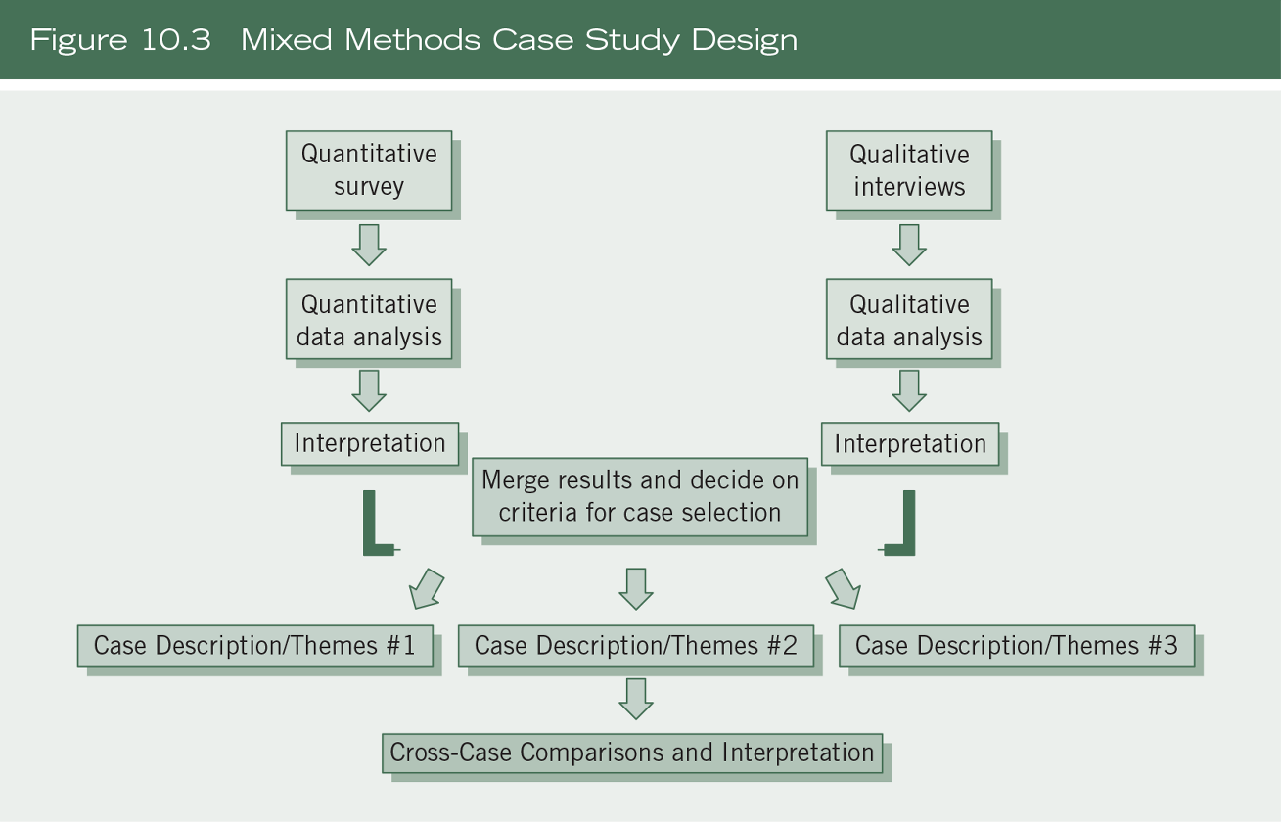
Types of Mixed Methods Designs

Slide 26
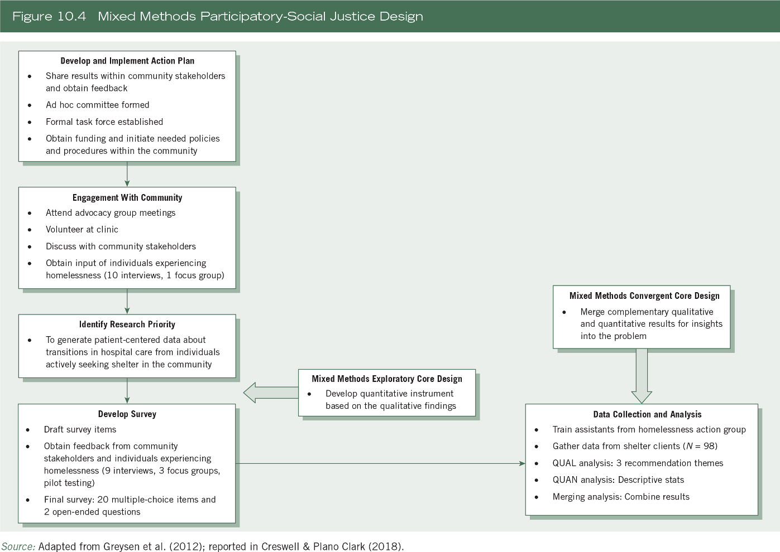
Types of Mixed Methods Designs

Slide 27
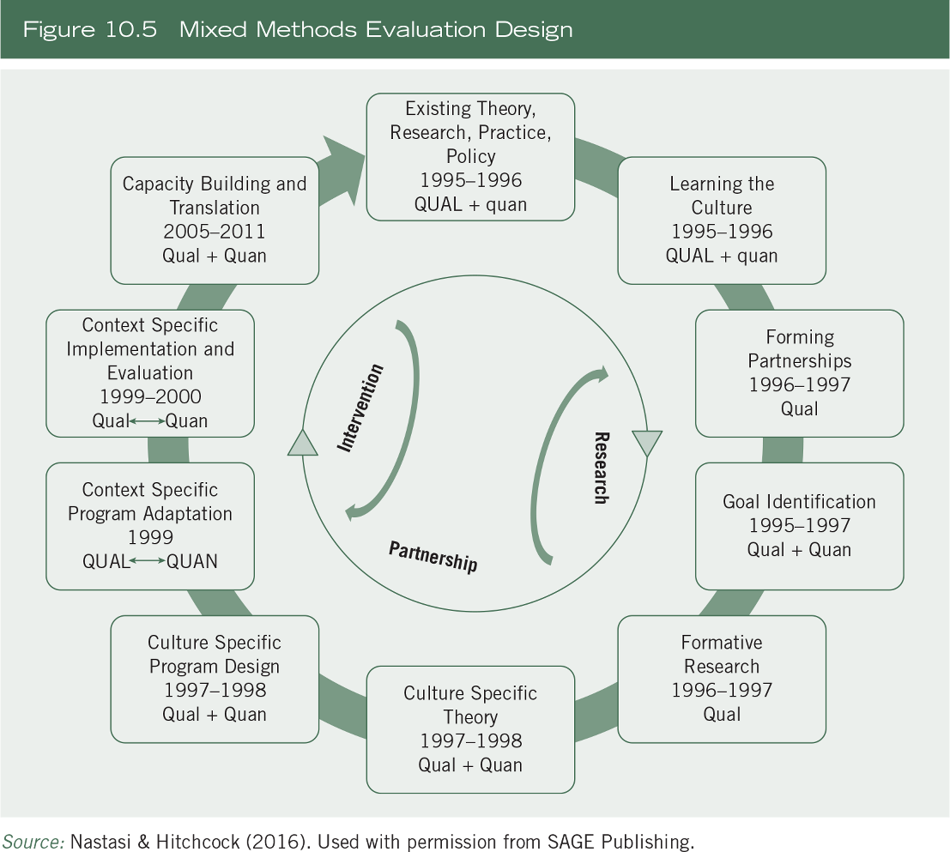
Types of Mixed Methods Designs

Slide 28
A Procedure for Embedding Core Designs into Complex Designs
Identify quantitative and qualitative data collection
Draw a diagram of steps
Look in steps for opportunities to collect quantitative and qualitative data
How databases are connected
Procedures of using core designs

Slide 29
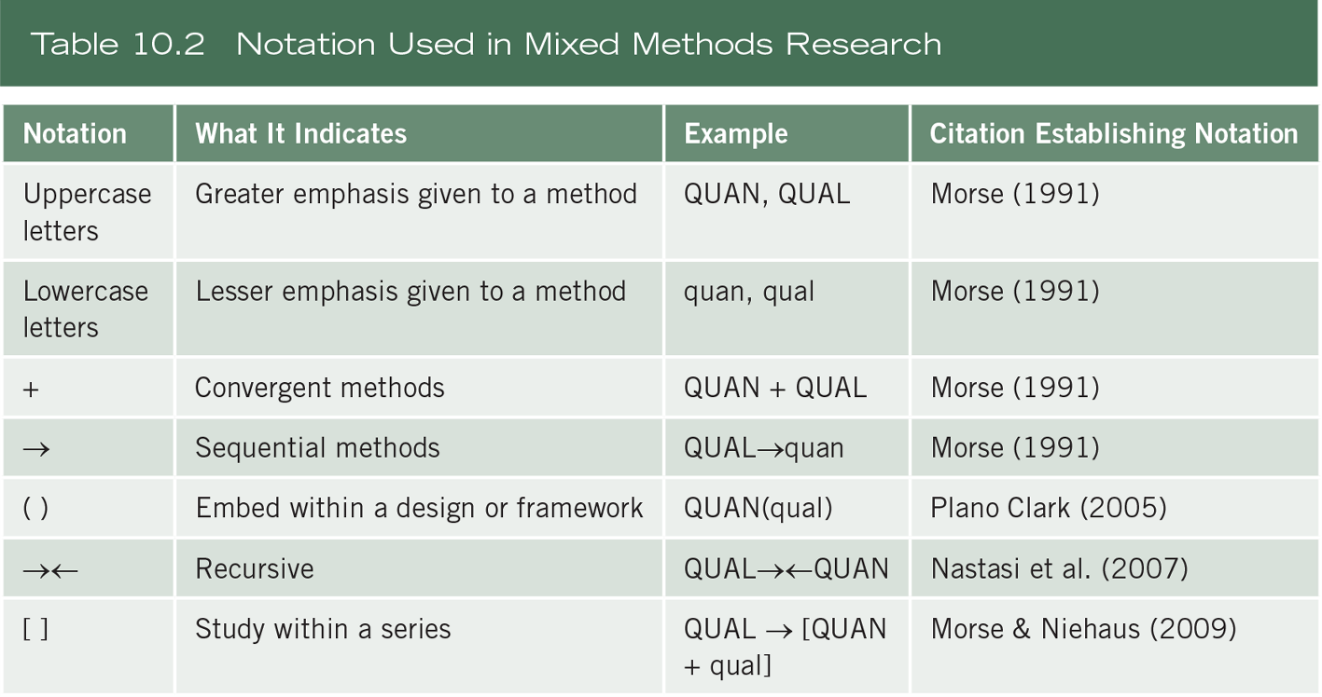
A Procedure for Embedding Core Designs into Complex Designs

Slide 30
Factors Important in Choosing a Mixed Methods Design
Choice based on
  Outcomes expected
  Integrating data
  Timing in mixed methods data collection – concurrent or sequential
  Emphasis placed on each database – equal or unequal
  Design most suited for a field
  Single researcher or team

Slide 31
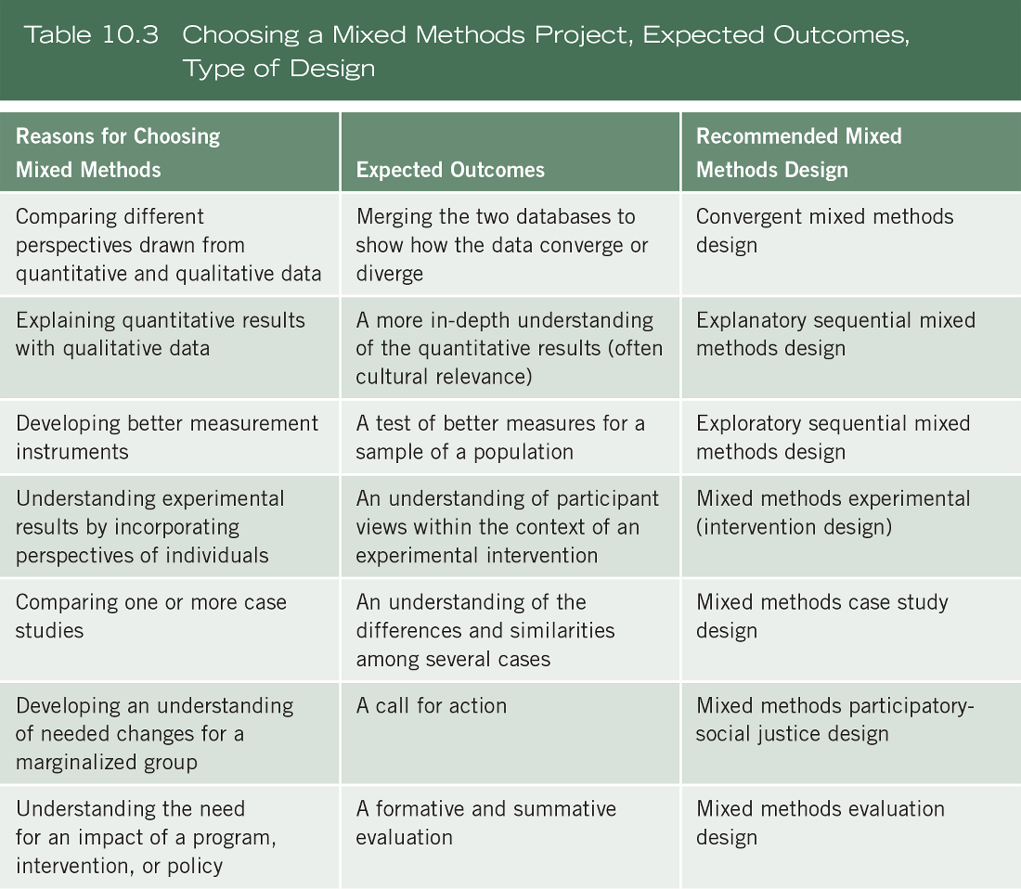
Factors Important in Choosing a Mixed Methods Design

Slide 32
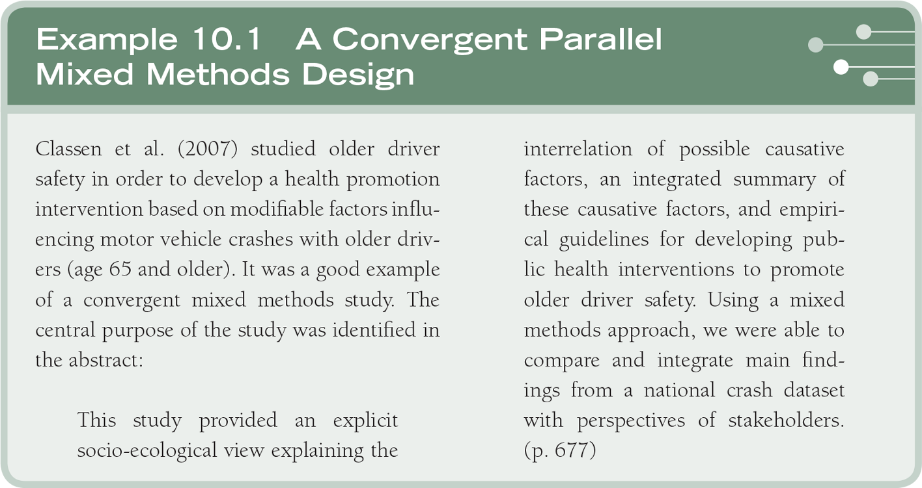
Examples of Mixed Methods Procedures

Slide 33
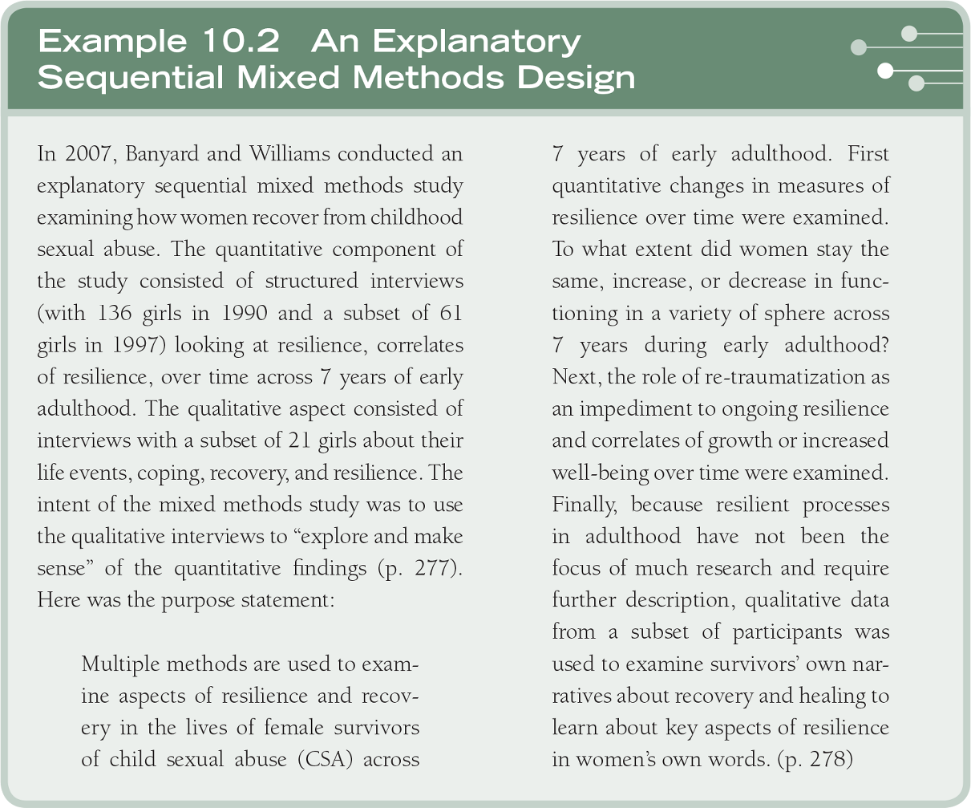
Examples of Mixed Methods Procedures

Slide 34
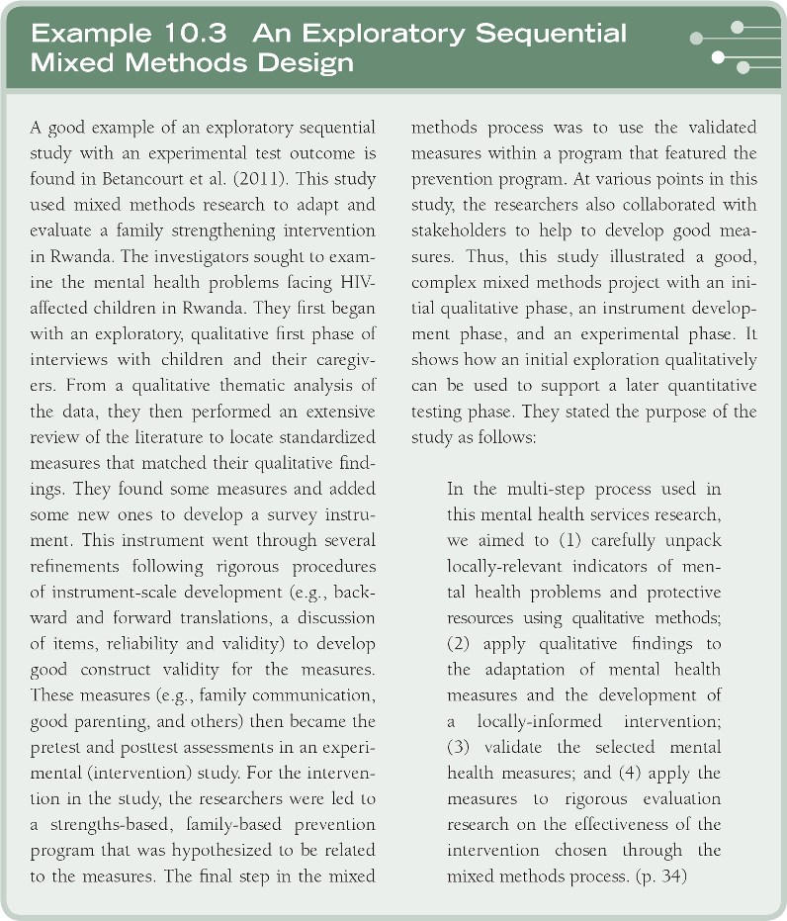
Examples of Mixed Methods Procedures

Slide 35
Summary
Define mixed methods and core characteristics
Mention historical evolution
Discuss chosen mixed methods design and challenges
Draw a diagram of procedures
Convey elements based on your design

